Slide 1
CS010 802: ARTIFICIAL INTELLIGENCE
Module -1
Problems- problem spaces and search, production systems, Problem characteristics, Searching strategies – Generate and Test, Heuristic Search Techniques- Hill climbing– issues in hill climbing, General Example Problems.
Python-Introduction to Python- Lists Dictionaries & Tuples in Python- Python implementation of Hill Climbing

Slide 2
Artificial Intelligence
Artificial intelligence is the study of how to make computers do things which, at the moment, people do better. Much of the early work in AI focused on formal tasks, such as game playing and theorem proving.
Ex. For game playing programs are
Checkers playing program,
Chess.
Ex. For theorem proving programs are
Logic theorist,
Galernter’s theorem prover

Slide 3
Artificial intelligence is a system that thinks like human beings.
AI is an exciting effort to make computers think… machines with minds, in the full and literal sense.
AI is the automation of activities that we associate with human thinking, activities such as decision making, problem solving, learning.
Artificial intelligence is a system that thinks rationally.
AI is the study of mental faculties through the use of computational models.
AI is the study of computations that make it possible to perceive, reason and act.

Slide 4
Artificial intelligence is a system that acts like human beings.
AI is the art of creating machines that perform functions that require intelligence when performed by people.
AI is the study of how to make computers do things at which , at the moment , people do better.
Artificial intelligence is a system that acts rationally.
AI is the study of the design of intelligent agents.
AI is concerned with intelligent behavior in artifacts.

Slide 5
AI application areas
The 2 most fundamental concerns of AI researchers are knowledge representation and search.
Knowledge representation
It addresses the problem of capturing the full range of knowledge required for intelligent behavior in a formal language, i.e. One suitable for computer manipulation.
Eg. Predicate calculus,
LISP, Prolog
Search
It is a problem solving technique that systematically explores a space of problem states, ie, successive and alternative stages in the problem solving process.

Slide 6
The following explains the major application areas of AI.
Game playing
Heuristics
Automated reasoning and theorem proving
Expert systems
Natural language understanding and semantic modeling
Planning and Robotics
Machine learning
Neural networks and Genetic algorithms

Slide 7
Problems
Problems can be classified as toy problems and real world problems.
A toy problem is intended to illustrate or exercise various problem solving methods. It can be used by different researchers to compare the performance of algorithms.
A real world problem is one whose solutions people actually care about.

Slide 8
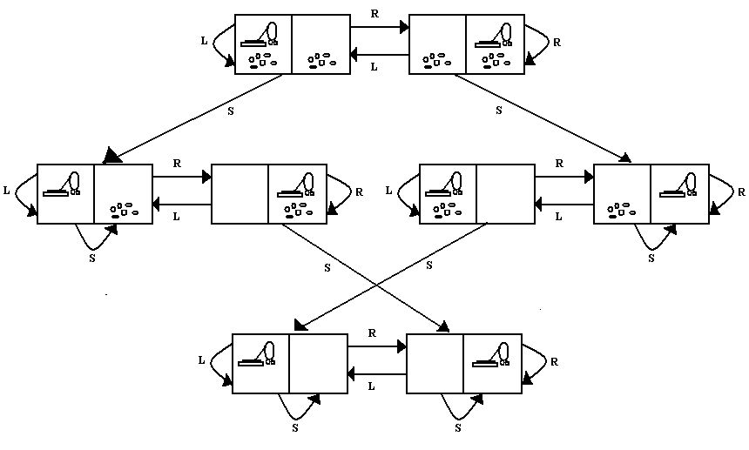
Toy problems
The first example is the
Vacuum world
The agent is in one of the 2 locations, each of which might or might not contain dirt.
Any state can be designated as the initial state.
After trying these actions (Left, Right, Suck), we get another state.
The goal test checks whether all squares are clean.

Slide 9
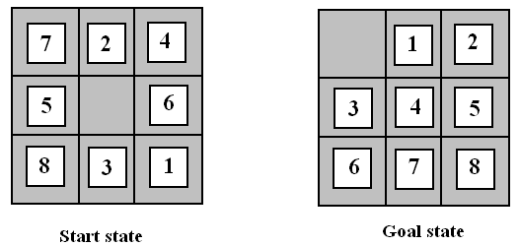
8 – puzzle problem
It consists of a 3 X 3 board with 8 numbered tiles and a blank space as shown below.
A tile adjacent to the blank space can slide into the space. The aim is to reach a specified goal state, such a s the one shown on the right of the figure.

Slide 10
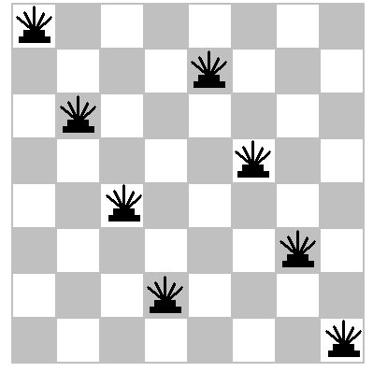
8 – Queens problem
The goal of 8- queens’ problem is to place 8 queens on a chess board such that no queen attacks any other.
(a queen attacks any piece in the same row, column or diagonal). Figure shows an attempted solution that fails: the queen in the rightmost column is attacked by the queen at the top left.

Slide 11
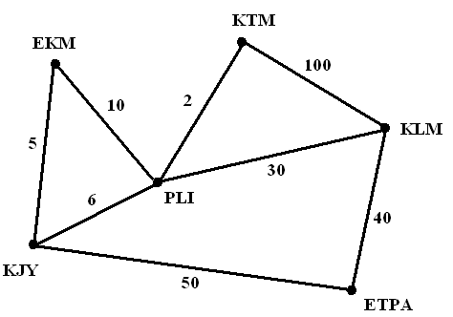
Real world problems
Route finding problem
Route finding algorithms are used in a variety of applications, such as routing in computer networks, military operations planning and air line travel planning systems.
Touring problems
They are related to route finding problems. For example, consider the figure.
Consider the problem. ‘Visit every city in the figure at least once starting and ending in Palai’. Each state must include not just the current location but also the set of cities the agent has visited.
Traveling salesperson problem (TSP)
Is a touring problem in which each city must be visited exactly once. The aim is to .find the shortest tour.

Slide 12
PROBLEMS & PROBLEM SPACES
Problems
To build a system to solve a particular problem, we need to do 4 things.
1. Define the problem precisely. This includes the initial state as well as the final goal state.
2. Analyze the problem.
3. Isolate and represent the knowledge that is needed to solve the problem.
4. Choose the best problem solving technique and apply it to the particular problem.

Slide 13
Problem spaces
Problem space -- Define the problem as state space search
The game of tic-tac-toe
Starting with an empty board, the first player may place an X in any one of nine places.
Each of these moves yields a different board that will allow the opponent 8 possible responses and so on.
We can represent this collection of possible moves and responses by regarding each board configuration as a node in a graph.
The links of the graph represent legal moves from one board configuration to another. These nodes correspond to different states of the game board.
The resulting structure is called a state space graph.

Slide 14
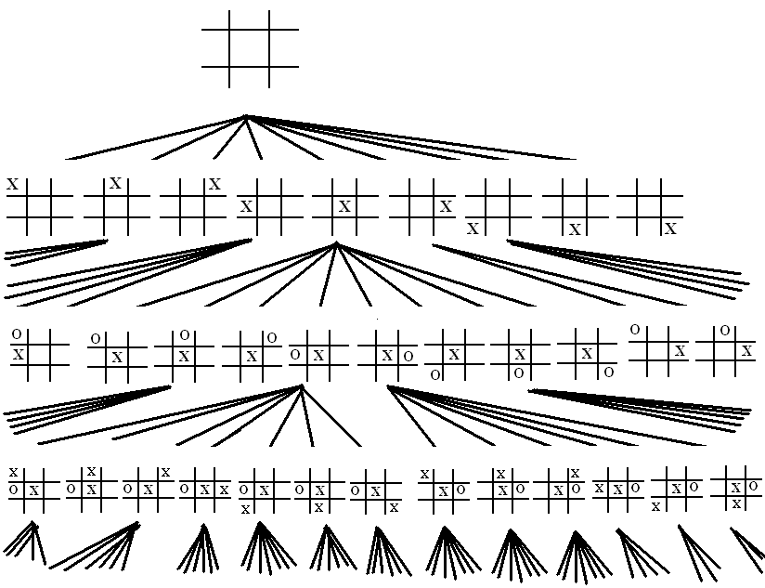

Slide 15
Water jug problem
Given two jugs, a 4-gallon and 3-gallon having no measuring markers on them. There is a pump that can be used to fill the jugs with water. How can you get exactly 2 gallons of water into 4-gallon jug.
The state space for this problem can be described as the set of ordered pairs of integers (x,y), such that x=0,1,2,3 or 4 and y=0,1,2 or 3.; x represents the number of gallons of water in the 4 gallon jug, and y represents the quantity of water in the 3 gallon jug.
Solution: State space for this problem can be described as the set of ordered pairs of integers (X, Y) such that X represents the number of gallons of water in 4-gallon jug and Y for 3-gallon jug.
1. Start state is (0,0)
2. Goal state is (2, N) for any value of N.

Slide 16
Following are the production rules for this problem
6. (x, y) → (x, 0)
if y > 0
7. (x, y) → (4, y − (4 − x))
if x + y ≥ 4, y > 0
8. (x, y) → (x − (3 − y), 3)
if x + y ≥ 3, x > 0
9. (x, y) → (x + y, 0)
if x + y ≤ 4, y > 0
10. (x, y) → (0, x + y)
if x + y ≤ 3, x > 0
11. (0, 2) → (2, 0)
12. (2, y) → (0, y)
1. (x, y) → (4, y)
if x < 4
2. (x, y) → (x, 3)
if y < 3
3. (x, y) → (x − d, y)
if x > 0
4. (x, y) → (x, y − d)
if y > 0
5. (x, y) → (0, y)
if x > 0

Slide 17
1. current state = (0, 0)
2. Loop until reaching the goal state (2, 0)
- Apply a rule whose left side matches the current state
- Set the new current state to be the resulting state
(0, 0)
(0, 3) Production No :2
(3, 0) Production No : 9
(3, 3) Production No :2
(4, 2) Production No :7
(0, 2) Production No : 5 or 12
(2, 0) Production No : 9 or 11

Slide 18
In order to provide a formal description of a problem, we must do the following.
Define a state space that contains all the possible configurations of the relevant objects.
Specify one or more states within that space that describe possible situations from which the problem solving process may start. These states are called the initial states.
Specify one or more states that would be acceptable as solutions to the problem. These states are called goal states.
Specify a set of rules that describe the actions available.

Slide 19
Production Systems
Production systems are useful to structure AI programs to describe search process. ie. it describes the way to find the solution.
A production system consists of:
A set of rules, each consisting of a left side that determines the applicability of the rule and a right side that describe the action to be performed if rule is applied.
One or more knowledge/database that contain whatever information appropriate for a task.
A control strategy that specifies the order in which rules will be compared to the database and a way of resolving the conflicts that arise when several rules match at once.
A rule applier

Slide 20
Different classes of production systems are:
A monotonic production system : in which the application of rule never prevents the latter application of another rule that could also have been applied at the time the first rule was selected. A non-monotonic production system is one which this is not true.
A partially commutative production system is a production system with the property that if the application of a particular sequence of a rule transforms state x into state y, then any permutation of those rules also transforms state x into state y. A commutative production system is a production system that is both monotonic and partially commutative.
 | monotonic | Non-monotonic
partially commutative | Theorem proving | Robot navigation
Not partially commutative | Chemical synthesis | Bridge

Slide 21
Control Strategies
When more than one rule matches the current state, we have to decide which rule to apply next during the process of searching for a solution to a problem.
Requirements of a good search strategy:
1. It causes motion
Otherwise, it will never lead to a solution.
Eg: suppose we are searching the rule from the beginning and selecting the first applicable one. We would never solve the problem. Keep on filling the 4-gallon jug
2. It is systematic
Otherwise, it may use more steps than necessary.
Eg: suppose we are randomly selecting the rule. It causes change & will lead to solution eventually. Because it is not systematic, we may enter useless sequences of operations.
3. It is efficient
Find a good, but not necessarily the best, answer

Slide 22
Problem characteristics
In order to choose the most appropriate method for a particular problem, it is necessary to analyze the problem along several dimensions.
Is the problem decomposable into a set of independent smaller or easier sub problems?
Can solution steps be ignored or at least undone if they prove unwise?
Is the problem’s universe predictable?
Is a good solution to the problem obvious without comparison to all other possible solutions?
Is the desired solution a state of the world or a path to a state?
Is a large amount of knowledge absolutely required to solve the problem, or is knowledge important only to constrain the search?
Can a computer that is simply given the problem return the solution, or will the solution of the problem require interaction between the computer and a person?

Slide 23
Is the problem decomposable?
Suppose we want to solve the problem of computing the expression
∫ ( x² + 3x + Sin² x . Cos² x ) dx
We can solve this problem by breaking it down into 3 smaller problems, each of which can then solve by using a small collection of specific rules.
∫ x² +3x + sin²x. cos²x. dx
∫ x² dx ∫ 3x dx ∫ sin²x cos²x dx

Slide 24
Can solution steps be ignored or undone?
Here we can divide problems into 3 classes.
Ignorable -- in which solution steps can be ignored. Eg: Theorem proving
Recoverable -- in which solution steps can be undone. Eg: 8-puzzle
Irrecoverable -- which solution steps cannot be undone.eg: Chess
Is the universe predictable?
Certain outcome problems (eg. 8 puzzle)
Uncertain outcome problems (eg. Bridge)

Slide 25
Is a good solution absolute or relative?
Best path problems (eg. Traveling salesman problem )
Any path problems
Consider the problem of answering questions based on a database of simple facts, such as the following.
Marcus was a man.
Marcus was a Pompean.
Marcus was born in 40 A. D.
all men are mortal.
All pompeans died when the volcano erupted in 79 A. D.
No mortal lives longer than 150 years.
It is now 1991 A. D.
Suppose we ask the question. “Is Marcus alive?”. By representing each of these facts in a formal language, such as predicate logic, and then using formal inference methods, we can fairly easily derive an answer to the question. The following shows 2 ways of deciding that Marcus is dead.

Slide 26
axioms
1. Marcus was a man. 1
4. All men are mortal. 4
8. Marcus is mortal. 1,4
3. Marcus was born in 40 A.D. 3
7. It is now 1991 A. D. 7
9. Marcus’ age is 1951 years. 3,7
6. no mortal lives longer than 150 years. 6
10. Marcus is dead. 8,6,9
OR
7. It is now 1991 A.D. 7
5. All Pompeans died in 79 A. D. 5
11. All Pompeans are dead now. 7,5
2. Marcus was a Pompoean. 2
12. Marcus is dead. 11,2
Since all we are interested in is the answer to the question, it does not matter which path we follow.

Slide 27
Is the solution a state or a path?
Problems whose solution is a state of the world. eg. Natural language understanding
Problems whose solution is a path to a state?
Eg. Water jug problem

Slide 28
What is the role of knowledge?
Problems for which a lot of knowledge is important only to constrain the search for a solution.
Eg. Chess
Consider the problem of playing chess. How much knowledge would be required by a perfect chess playing program? Just the rules for determining the legal moves and some simple control mechanism that implements an appropriate search procedure.
Problems for which a lot of knowledge is required even to be able to recognize a solution.
Eg. News paper story understanding
Consider the problem of scanning daily newspapers to decide which are supporting democrats and which are supporting the republicans in some upcoming election. How much knowledge would be required by a computer trying to solve this problem? Here a great deal of knowledge is necessary.

Slide 29
Does the task require interaction with a person?
Solitary problems
Here the computer is given a problem description and produces an answer with no intermediate communication and with no demand for an explanation for the reasoning process.
Consider the problem of proving mathematical theorems. If
All we want is to know that there is a proof.
The program is capable of finding a proof by itself.
Then it does not matter what strategy the program takes to find the proof.
Conversational problems
In which there is intermediate communication between a person and the computer, either to provide additional assistance to the computer or to provide additional information to the user.

Slide 30
Searching Strategies / Heuristic Search
Heuristics are criteria for deciding which among several alternatives be the most effective in order to achieve some goal.
Heuristic is a technique that
Improves the efficiency of a search process possibly by sacrificing claims of systematicity and completeness.
It no longer guarantees to find the best answer but almost always finds a very good answer.
Using good heuristics, we can hope to get good solution to hard problems (such as travelling salesman) in less than exponential time.
There are general-purpose heuristics that are useful in a wide variety of problem domains.
We can also construct special purpose heuristics, which are domain specific.

Slide 31
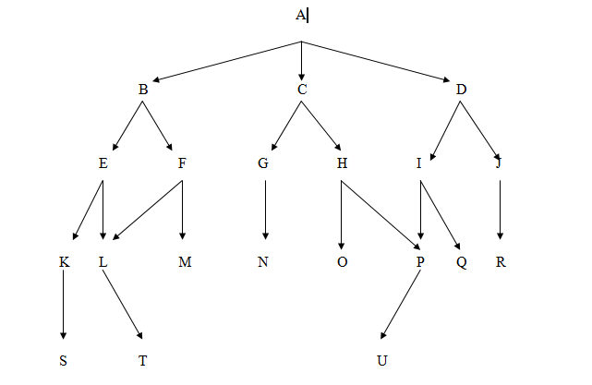
Basic search strategies Breadth first search
States are labeled (A, B, C….)
Breadth first search explores the space in a level by level fashion.
Only when there are no more states to be explored at a given level does the algorithm move on to the next level.
A breadth first search of the above graph considers the states in the order A, B, C, D, E, F, G, H, I, J, K, L, M, N, O, P, Q, R, S, T, U

Slide 32
void breadth_ first _ search ( )
{
open = [ start ];
closed = [ ];
while ( open not empty )
{
Remove the leftmost state from open, call it X;
if X is a goal,
then return SUCCESS;
else
{
Generate children of X;
Put X on closed;
Discard children of x, if already on open or closed;
Put remaining children on right end of open;
}
}
return FAIL;
}

Slide 33
A trace of the breadth first search on the graph appears below.
Open Closed
A empty
BCD A
CDEF BA
DEFGH CBA
EFGHIJ DCBA
FGHIJKL EDCBA
GHIJKLM FEDCBA
HIJKLMN GFEDCBA
And so on until open = [ ].
BFS explores the space in level by level
It moves to next level, only when there is no more stste to be visited at a given level.
Its implemented using FIFO data structure. Open_Oueue
If there is a solution, then BFS is guaranteed to find it. If there are multiple solution then minimal solution will be found.

Slide 34
Depth first search
Depth first search goes deeper in to the search space whenever this is possible.
Depth first search examines the states in the graph in the order A, B, E, K, S, L, T, F, M, C, G, N, H, O, P, U, D, I, Q, J, R.
In depth first search, the descendent states are added and removed from the left end of open.
That is, open is maintained as a stack (LIFO) data structure.

Slide 35
void depth_first_search ()
{
open = [start];
closed = [ ];
while (open not empty )
{
remove leftmost state from open, call it X;
if X is a goal state
then return SUCCESS;
else
{
generate children of X;
put X on closed;
discard children of X, if already on open or closed;
put remaining children on left end of open;
}
}
return FAIL;
}

Slide 36
A trace of depth first search on the above graph is shown below.
open closed
A empty
B C D A
E F C D B A
K L F C D E B A
S L F C D K E B A
L F C D S K E B A
T F C D L S K E B A
F C D T L S K E B A
M C D F T L S K E B A
C D M F T L S K E B A
G H D C M F T L S K E B A
And so on until open = [ ];
Open is implemented using stack LIFO
DFS goes deeper in search space whenever this is possible.
It requires less memory since only one path on the current path are stored.
DFS may find a solution, that may not be the minimal solution. Ie, its not guaranteed to find the best solution.

Slide 37
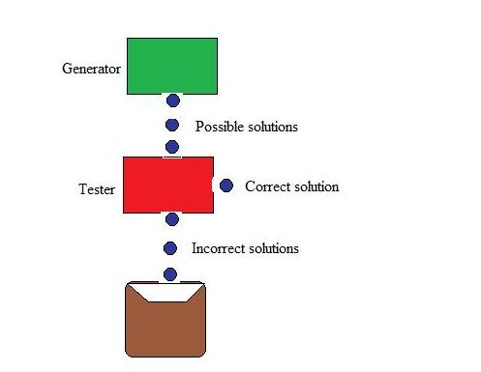
ALGORITHM GENERATE AND TEST
Generate and test is the simplest of all the approaches.
Potential solutions that need to be generated vary depending on the kinds of problems.
For some problems the possible solutions may be particular points in the problem space and for some problems, path from the start state.
Steps:
Generate a possible solution
Test to see if this is the expected solution
If the solution has been found, quit else go to step1.

Slide 38
Generate and test like depth-first search, requires that complete solutions be generated for testing. In its most systematic form, it is only an exhaustive search of the problem space. Solutions can also be generated randomly but solution is not guaranteed.
Systematic Generate and Test
While generating complete solutions and generating random solutions are two extremes there exists another approach that lies in between. The approach is that search process proceeds systematically but some paths that unlikely to lead the solutions are not considered. This evaluation is performed by a heuristic function.
DFS tree with backtracking can be used to implement systematic generate and test procedure. As per this procedure if some intermediate states are likely to appear often in the tree, it would be better to modify that procedure to traverse a graph rather than a tree.

Slide 39
HILL CLIMBING
Hill climbing strategies expand the current state in the search and evaluate its children.
The best child is selected for further expansion; neither its siblings nor its parent is retained.
Search halts when it reaches a state that is better than any of its children.
Hill climbing is named for the strategy that might be used by an eager, but blind mountain climber: go uphill along the steepest possible path until you can go no farther.
Because it keeps no history, the algorithm cannot recover from failures of its strategy.
There are three various strategies for hill climbing. They are
Simple hill climbing,
Steepest ascent hill climbing and
Simulated annealing.

Slide 40
Simple hill climbing
The simplest way to implement hill climbing is as follows.
Algorithm
Evaluate the initial state. If it is also a goal state, then return it and quit. Otherwise continue with the initial state as the current state.
Loop until a solution is found or until there are no new operators left to be applied in the current state:
Select an operator that has not yet been applied to the current state and apply it to produce a new state.
Evaluate the new state,
If it is a goal state, then return it and quit.
If it is not a goal state, but it is better than the current state, then make it the current state.
If it is not better than the current state, then continue in the loop.

Slide 41
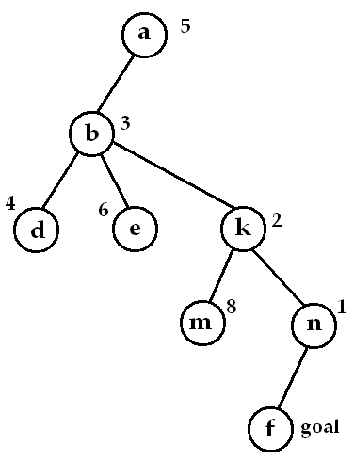
A problem is given. Given the start state as ‘a’ and the goal state as ‘f’.
Suppose we have a heuristic function h (n) for evaluating the states. Assume that a lower value of heuristic function indicates a better state.
Simple hill climbing may fail to find a solution. Either algorithm may stop not by finding a goal state but by getting to a state from which no better states can be generated. This will happen if the program has reached a local maximum, a plateau or a ridge

Slide 42
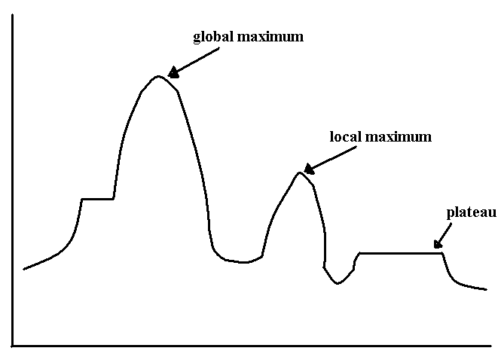
(a) A "local maximum” which is a state better than all its neighbors, but is not better than some other states farther away. Local maxim sometimes occurs within sight of a solution. In such cases they are called “Foothills".
(b) A "plateau'' which is a flat area of the search space, in which neighboring states have the same value. On a plateau, it is not possible to determine the best direction in which to move by making local comparisons.
(c) A "ridge" which is an area in the search that is higher than the surrounding areas, but cannot be searched in a simple move. flat like a plateau, but with drop-offs to the sides; steps to the North, East, South and West may go down, but a step to the NW may go up.

Slide 43
To overcome these problems :
Back track to some earlier nodes and try a different direction. This is a good way of dealing with local maxim.
Make a big jump and some direction to a new area in the search. This can be done by applying two more rules of the same rule several times, before testing. This is a good strategy is dealing with plateau and ridges.
Apply 2 or more rules before doing the test. This corresponds to moving in several directions at once. This is a good way for dealing with ridges.
Hill climbing becomes inefficient in large problem spaces, and when combinatorial explosion occurs. But it is a useful when combined with other methods.

Slide 44
Steepest ascent hill climbing
A useful variation on simple hill climbing considers all the moves from the current state and selects the best one as the next state.
Algorithm
Evaluate the initial state. If it is also a goal state, then return it and quit. Otherwise, continue with the initial state as the current state.
Loop until a solution is found or until a complete iteration produces no change to current state.
Let SUCC be a state such that any possible successor of the current will be better than SUCC.
For each operator that applies to the current state, do:
Apply the operator and generate a new state.
Evaluate the new state. If it is a goal state, then return it and quit. If not, compare it to SUCC. If it is better, then set SUCC to this state. If it is not better, leave SUCC alone.
c. if the SUCC is better than current state, then set current state to SUCC.

Slide 45
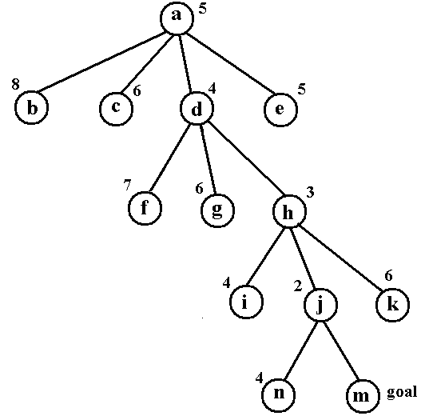

Slide 46
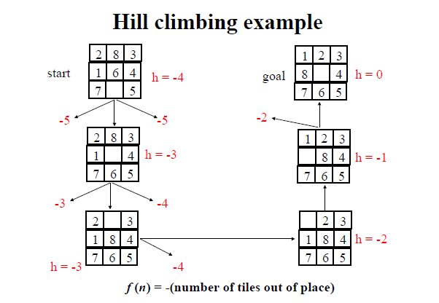
Hill climbing is not always very effective. It is practically unsuited to problems where the value of the heuristic function drops off suddenly as you move away from a solution. Hill climbing is a local method, by which we mean that it decides what to do next by looking only at the “immediate” consequences of its choice rather than exploring all the consequences.

Slide 47
SIMULATED ANNEALING
We have seen that hill climbing never makes a downhill move. As a result, it can stuck on a local maximum.
In contrast, a purely random walk- that is, moving to a successor chosen uniformly at random from the set of successors- is complete, but extremely inefficient.
Simulated annealing combines hill climbing with a random walk. As a result, it yields efficiency and completeness.
Simulated annealing is a variation of hill climbing in which, at the beginning of the process, some downhill moves may be made.
The idea is to do enough exploration of the whole space early on so that the final solution is relatively insensitive to the starting state.
This should lower the chances of getting caught at a local maximum, a plateau or a ridge.

Slide 48
In metallurgy, annealing is the process in which metals are melted and then gradually cooled until some solid state is reached.
It is used to tamper or harden metals and glass by heating them to a high temperature and then gradually cooling them, thus allowing the material to coalesce in to a low energy crystalline state.
Physical substances usually move from higher energy configurations to lower ones.
But there is some probability that a transition to a higher energy state will occur. This probability is given by the function
P = e^{-∆E / kT}
Where ∆E is positive change in the energy level, T is the temperature and k is Boltzmann’s constant.

Slide 49
Algorithm
Evaluate the initial state. If it is also a goal state, then return it and quit. Otherwise, continue with the initial state as the current state.
Initialize BEST-SO-FAR to the current state.
Initialize T according to the annealing schedule.
Loop until a solution is found or until there are no new operators left to be applied in the current state.
Select an operator that has not yet been applied to the current state and apply it to produce a new state.
Evaluate the new state. Compute
∆E = (value of current) – (value of new state)
If the new state is a goal state, then return it and quit.
If it is not a goal state, but is better than the current state, then make it the current state. Also set BEST-SO-FAR to this new state.
If it is not better than the current state, then make it the current state with probability p’ as defined above. This step is usually implemented by invoking a random number generator to produce a number in the range [ 0, 1]. If that number is less than p’, then the move is accepted. Otherwise, do nothing.
Revise T as necessary according to the annealing schedule.
5. Return BEST- SO- FAR as the answer.

Slide 50
To implement this algorithm, it is necessary to maintain an annealing schedule.
That is first we must decide the initial value to be used for temperature.
The second criterion is to decide when the temperature of the system should be reduced. The third is the amount by which the temperature will be reduced each time it is changed.
In this algorithm, instead of picking the best move, it picks a random move.
If the move improves the situation, it is always accepted.
Otherwise the algorithm accepts the move with some probability less than 1.
The probability decreases exponentially with the amount ∆E by which the evaluation is worsened.
The probability also decreases as the temperature T goes down. Thus bad moves are more likely to be allowed at the start when the temperature is high, and they become more unlikely as T decreases.

Slide 51
Simulated annealing was first used extensively to solve VLSI layout problems.
The algorithm for simulated annealing is slightly different from the simple hill climbing.
The annealing schedule must be maintained.
Moves to worse states may be accepted
It maintains the current state as well as best_state_found so far. Then if the final state is worse than that earlier state, the earlier state is still available.

Slide 52
Python

Slide 53
Overview
History
Names & Assignment
Sequences types: Lists, Tuples, and Strings

Slide 54
Brief History of Python
Invented in the Netherlands, early 90s by Guido van Rossum
Named after Monty Python
Open sourced from the beginning
Considered a scripting language, but is much more
Scalable, object oriented and functional from the beginning
Used by Google from the beginning
Increasingly popular

Slide 55

Python’s Benevolent Dictator For Life
“Python is an experiment in how much freedom program-mers need. Too much freedom and nobody can read another's code; too little and expressive-ness is endangered.”
- Guido van Rossum

Slide 56
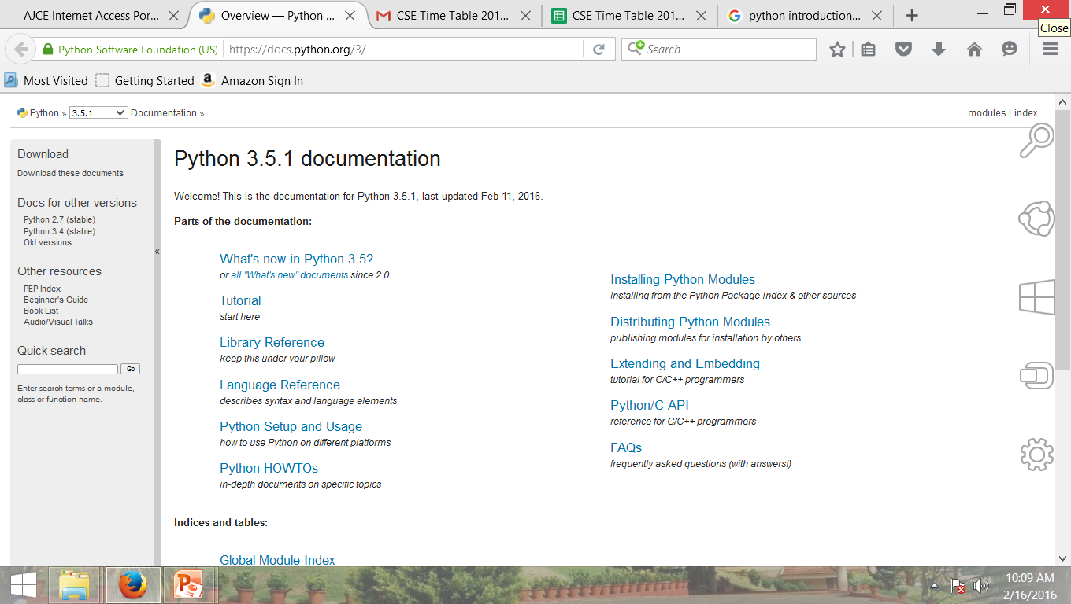
http://docs.python.org/

Slide 57
The Basics

Slide 58
A Code Sample
x = 34 - 23
# A comment.
y = “Hello”
# Another one.
z = 3.45
if z == 3.45 or y == “Hello”:
x = x + 1
y = y + “ World” # String concat.
print x
print y

Slide 59
Enough to Understand the Code
Indentation matters to code meaning
Block structure indicated by indentation
First assignment to a variable creates it
Variable types don’t need to be declared.
Python figures out the variable types on its own.
Assignment is = and comparison is ==
For numbers + - * / % are as expected
Special use of + for string concatenation and % for string formatting (as in C’s printf)
Logical operators are words (and, or, not) not symbols
The basic printing command is print

Slide 60
Basic Datatypes
Integers (default for numbers)
z = 5 / 2 # Answer 2, integer division
Floats
x = 3.456
Strings
Can use “” or ‘’ to specify with “abc” == ‘abc’
Unmatched can occur within the string: “matt’s”
Use triple double-quotes for multi-line strings or strings than contain both ‘ and “ inside of them: “““a‘b“c”””

Slide 61
Whitespace
Whitespace is meaningful in Python: especially indentation and placement of newlines
Use a newline to end a line of code
Use \ when must go to next line prematurely
No braces {} to mark blocks of code, use consistent indentation instead
First line with less indentation is outside of the block
First line with more indentation starts a nested block
Colons start of a new block in many constructs, e.g. function definitions, then clauses

Slide 62
Comments
Start comments with #, rest of line is ignored
Can include a “documentation string” as the first line of a new function or class you define
Development environments, debugger, and other tools use it: it’s good style to include one
def fact(n):
“““fact(n) assumes n is a positive integer and returns facorial of n.””” assert(n>0)
return 1 if n==1 else n*fact(n-1)

Slide 63
Assignment
Binding a variable in Python means setting a name to hold a reference to some object
Assignment creates references, not copies
Names in Python do not have an intrinsic type, objects have types
Python determines the type of the reference automatically based on what data is assigned to it
You create a name the first time it appears on the left side of an assignment expression: x = 3
A reference is deleted via garbage collection after any names bound to it have passed out of scope
Python uses reference semantics (more later)

Slide 64
Naming Rules
Names are case sensitive and cannot start with a number. They can contain letters, numbers, and underscores.
bob Bob _bob _2_bob_ bob_2 BoB
There are some reserved words:
and, assert, break, class, continue, def, del, elif, else, except, exec, finally, for, from, global, if, import, in, is, lambda, not, or, pass, print, raise, return, try, while

Slide 65
Naming conventions
The Python community has these recommend-ed naming conventions
joined_lower for functions, methods and, attributes
joined_lower or ALL_CAPS for constants
StudlyCaps for classes
camelCase only to conform to pre-existing conventions
Attributes: interface, _internal, __private

Slide 66
Assignment
You can assign to multiple names at the same time
>>> x, y = 2, 3
>>> x
2
>>> y
3
This makes it easy to swap values
>>> x, y = y, x
Assignments can be chained
>>> a = b = x = 2

Slide 67
Sequence types: Tuples, Lists, and Strings

Slide 68
Sequence Types
Tuple: (‘john’, 32, [CMSC])
A simple immutable ordered sequence of items
Items can be of mixed types, including collection types
Strings: “John Smith”
Immutable
Conceptually very much like a tuple
List: [1, 2, ‘john’, (‘up’, ‘down’)]
Mutable ordered sequence of items of mixed types

Slide 69
Similar Syntax
All three sequence types (tuples, strings, and lists) share much of the same syntax and functionality.
Key difference:
Tuples and strings are immutable
Lists are mutable
The operations shown in this section can be applied to all sequence types
most examples will just show the operation performed on one

Slide 70
Sequence Types 1
Define tuples using parentheses and commas
>>> tu = (23, ‘abc’, 4.56, (2,3), ‘def’)
Define lists are using square brackets and commas
>>> li = [“abc”, 34, 4.34, 23]
Define strings using quotes (“, ‘, or “““).
>>> st = “Hello World”
>>> st = ‘Hello World’
>>> st = “““This is a multi-line
string that uses triple quotes.”””

Slide 71
Sequence Types 2
Access individual members of a tuple, list, or string using square bracket “array” notation
Note that all are 0 based…
>>> tu = (23, ‘abc’, 4.56, (2,3), ‘def’)
>>> tu[1] # Second item in the tuple.
‘abc’
>>> li = [“abc”, 34, 4.34, 23]
>>> li[1] # Second item in the list.
34
>>> st = “Hello World”
>>> st[1] # Second character in string.
‘e’

Slide 72
Positive and negative indices
>>> t = (23, ‘abc’, 4.56, (2,3), ‘def’)
Positive index: count from the left, starting with 0
>>> t[1]
‘abc’
Negative index: count from right, starting with –1
>>> t[-3]
4.56

Slide 73
Slicing: return copy of a subset
>>> t = (23, ‘abc’, 4.56, (2,3), ‘def’)
Return a copy of the container with a subset of the original members. Start copying at the first index, and stop copying before second.
>>> t[1:4]
(‘abc’, 4.56, (2,3))
Negative indices count from end
>>> t[1:-1]
(‘abc’, 4.56, (2,3))

Slide 74
Slicing: return copy of a =subset
>>> t = (23, ‘abc’, 4.56, (2,3), ‘def’)
Omit first index to make copy starting from beginning of the container
>>> t[:2]
(23, ‘abc’)
Omit second index to make copy starting at first index and going to end
>>> t[2:]
(4.56, (2,3), ‘def’)

Slide 75
Copying the Whole Sequence
[ : ] makes a copy of an entire sequence
>>> t[:]
(23, ‘abc’, 4.56, (2,3), ‘def’)
Note the difference between these two lines for mutable sequences
>>> l2 = l1 # Both refer to 1 ref,
# changing one affects both
>>> l2 = l1[:] # Independent copies, two refs

Slide 76
The ‘in’ Operator
Boolean test whether a value is inside a container:
>>> t = [1, 2, 4, 5]
>>> 3 in t
False
>>> 4 in t
True
>>> 4 not in t
False
For strings, tests for substrings
>>> a = 'abcde'
>>> 'c' in a
True
>>> 'cd' in a
True
>>> 'ac' in a
False
Be careful: the in keyword is also used in the syntax of for loops and list comprehensions

Slide 77
The + Operator
The + operator produces a new tuple, list, or string whose value is the concatenation of its arguments.
>>> (1, 2, 3) + (4, 5, 6)
(1, 2, 3, 4, 5, 6)
>>> [1, 2, 3] + [4, 5, 6]
[1, 2, 3, 4, 5, 6]
>>> “Hello” + “ ” + “World”
‘Hello World’

Slide 78
The * Operator
The * operator produces a new tuple, list, or string that “repeats” the original content.
>>> (1, 2, 3) * 3
(1, 2, 3, 1, 2, 3, 1, 2, 3)
>>> [1, 2, 3] * 3
[1, 2, 3, 1, 2, 3, 1, 2, 3]
>>> “Hello” * 3
‘HelloHelloHello’

Slide 79
Mutability: Tuples vs. Lists

Slide 80
Lists are mutable
>>> li = [‘abc’, 23, 4.34, 23]
>>> li[1] = 45
>>> li [‘abc’, 45, 4.34, 23]
We can change lists in place.
Name li still points to the same memory reference when we’re done.

Slide 81
Tuples are immutable
>>> t = (23, ‘abc’, 4.56, (2,3), ‘def’)
>>> t[2] = 3.14
Traceback (most recent call last):
File "<pyshell#75>", line 1, in -toplevel-
tu[2] = 3.14
TypeError: object doesn't support item assignment
You can’t change a tuple.
You can make a fresh tuple and assign its reference to a previously used name.
>>> t = (23, ‘abc’, 3.14, (2,3), ‘def’)
The immutability of tuples means they’re faster than lists.

Slide 82
Operations on Lists Only
>>> li = [1, 11, 3, 4, 5]
>>> li.append(‘a’) # Note the method syntax
>>> li
[1, 11, 3, 4, 5, ‘a’]
>>> li.insert(2, ‘i’)
>>>li
[1, 11, ‘i’, 3, 4, 5, ‘a’]

Slide 83
The extend method vs +
+ creates a fresh list with a new memory ref
extend operates on list li in place.
>>> li.extend([9, 8, 7])
>>> li
[1, 2, ‘i’, 3, 4, 5, ‘a’, 9, 8, 7]
Potentially confusing:
extend takes a list as an argument.
append takes a singleton as an argument.
>>> li.append([10, 11, 12])
>>> li
[1, 2, ‘i’, 3, 4, 5, ‘a’, 9, 8, 7, [10, 11, 12]]

Slide 84
Operations on Lists Only
Lists have many methods, including index, count, remove, reverse, sort
>>> li = [‘a’, ‘b’, ‘c’, ‘b’]
>>> li.index(‘b’) # index of 1st occurrence
1
>>> li.count(‘b’) # number of occurrences
2
>>> li.remove(‘b’) # remove 1st occurrence
>>> li
[‘a’, ‘c’, ‘b’]

Slide 85
Operations on Lists Only
>>> li = [5, 2, 6, 8]
>>> li.reverse() # reverse the list *in place*
>>> li
[8, 6, 2, 5]
>>> li.sort() # sort the list *in place*
>>> li
[2, 5, 6, 8]
>>> li.sort(some_function)
# sort in place using user-defined comparison

Slide 86
Tuple details
The comma is the tuple creation operator, not parens
>>> 1,
(1,)
Python shows parens for clarity (best practice)
>>> (1,)
(1,)
Don't forget the comma!
>>> (1)
1
Trailing comma only required for singletons others
Empty tuples have a special syntactic form
>>> ()
()
>>> tuple()
()

Slide 87
Summary: Tuples vs. Lists
Lists slower but more powerful than tuples
Lists can be modified, and they have lots of handy operations and mehtods
Tuples are immutable and have fewer features
To convert between tuples and lists use the list() and tuple() functions:
li = list(tu)
tu = tuple(li)

